Slide 1

Room Recommendation System PROJECT – VII Semester Prepared by: Anish Maharjan Samyog Aryal Sichu Sharma Subash Mishra

Slide 2
Introduction
Room Rental system will provide the Information about Rooms/Flats which is available for Rent.
The application will make easy to find the location of Rooms/Flats, select no. of rooms and other facts by the client.
It will make easy to upload the location, contact No., expected rent, No. of rooms, Facilities and other information by landlord.

Slide 3
Problem statement
It is difficult to find house for the client in a specific area.
It is also difficult to find the client on time, for the landlord.

Slide 4
Objective
To develop an efficient application that will be helpful for not only clients but also landlords.
To provide information and recommend the Rooms/Flats according to the input given by the client.
Makes communication between landlord and client easy.

Slide 5
Scopes
Apartments
Housing
Urban cities.

Slide 6
Limitation
Only available through internet.
Needs basic knowledge of computing device.

Slide 7
Algorithm
Cosine similarity

Slide 8
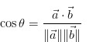
Cosine similarity
Cosine similarity is a measure of similarity between two non-zero vectors of an inner product space that measures the cosine of the angle between them.
It is used in positive space[0,1].

Slide 9
Tools used
Following are the tools and languages we are going to use for the implementation:
HTML
CSS
JavaScript
Php
MySQL
Bootstrap

Slide 10
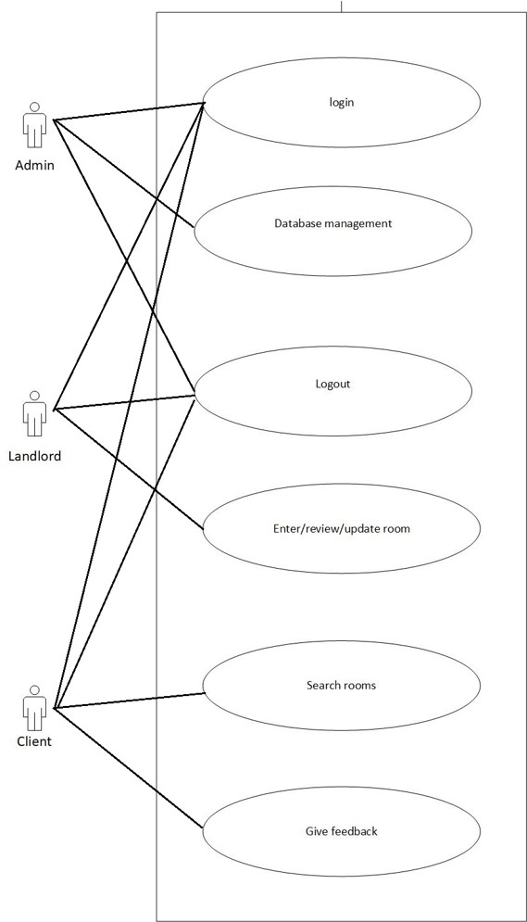
Use-case diagram

Slide 11
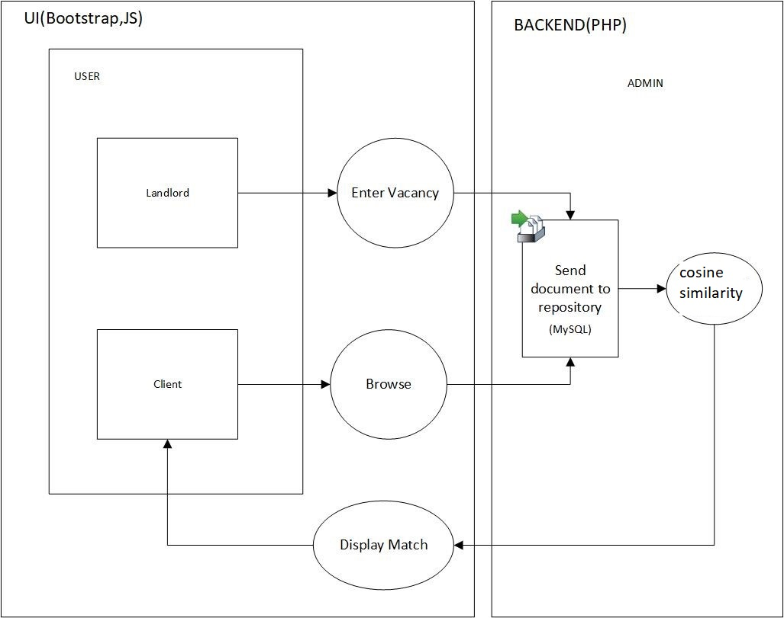
Architectural Design

Slide 12
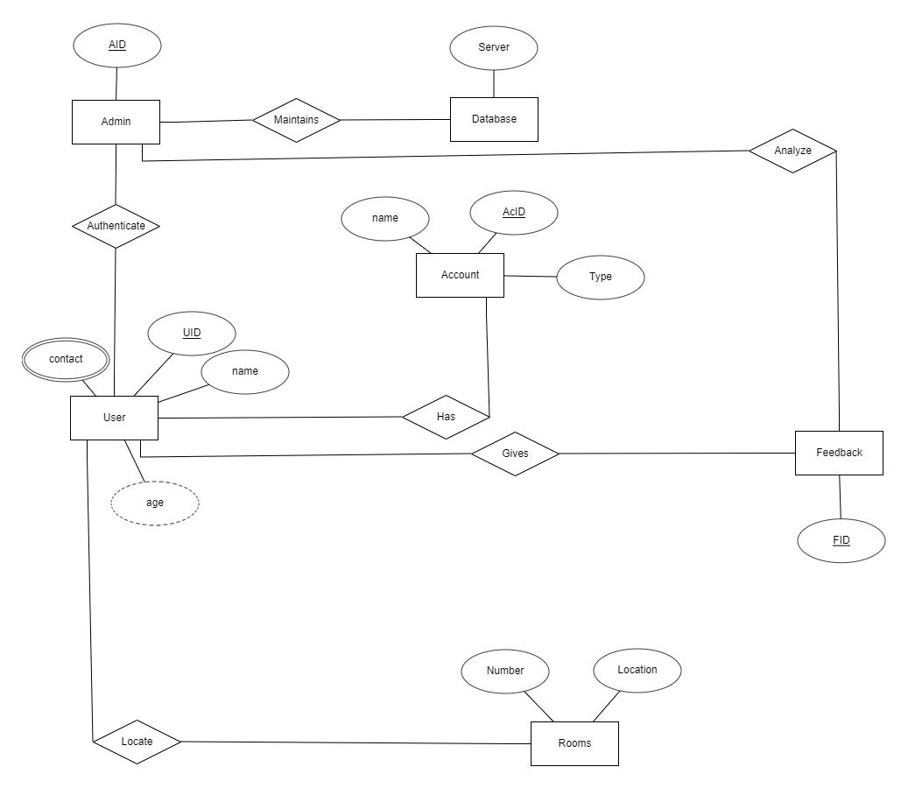
ER diagram

Slide 13
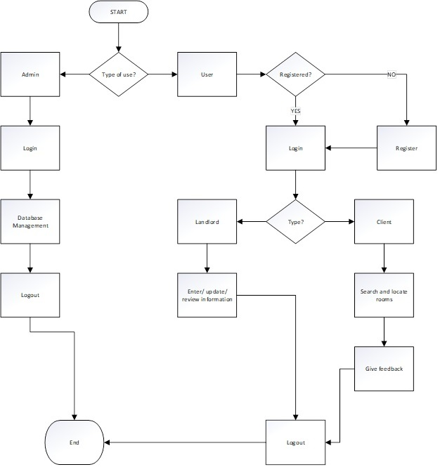
Flow chart

Slide 14
Output
Room Rental is a web service which will connect client to landlords and vice-versa.
It saves the physical hard work and invaluable time to find Rooms/Flats.

Slide 15
Conclusion
It helps to find the Rooms/Flats to the client.
It helps the landlord to fill the vacant Rooms/Flats.
It saves time for both clients and landlords

Slide 16
Future works
In the future, we are planning to add location tracking service of the user by using geolocation api.
The system then recommends the nearest location where the room is available using the data of location.

Slide 17
Working schedule
 | 1st | 2nd | 3rd | 4th | 5th |  | 6th | 7th | 8th | 9th | 10th | 11th | 12th
Study and Analysis |  | 4w
Data Collection |  |  |  |  | 3w
Implementation |  |  |  |  |  |  |  |  | 5w
Testing |  |  |  |  |  |  |  |  |  | 3w
Documentation |  |  |  |  |  |  |  |  |  |  |  | 3w
Review |  |  |  |  |  |  |  |  |  |  |  | 2w
Presentation |  |  |  |  |  |  |  |  |  |  |  |  | 1d

Slide 18
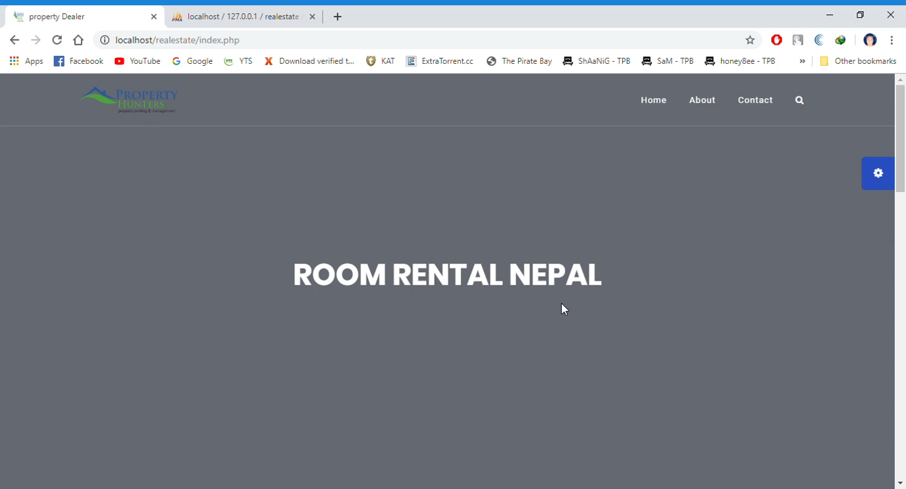
Demo

Slide 19
References
https://www.slideshare.net/NikhilKumawat4/room-rental-system
https://www.tutorialspoint.com/data_structures_algorithms/binary_search_algorithm.htm?fbclid=IwAR3FSa7R_B3PwSsHLlpqIMO6F9aFAjjgMdAI2K0b6kXzotBrVp73z-uVHHM

Slide 20


